Slide 1
NP Completeness

Slide 2
Cost and Complexity
Algorithm complexity can be expressed in Order notation, e.g. “at what rate does work grow with N?”:
  O(1) Constant
  O(logN) Sub-linear
  O(N) Linear
  O(NlogN) Nearly linear
  O(N²) Quadratic
  O(X^{N}) Exponential
But, for a given problem, how do we know if a better algorithm is possible?

Slide 3
The Problem of Sorting
For example, in discussing the problem of sorting:
Two algorithms to solve:
  Bubblesort – O(N²)
  Mergesort – O(N Log N)
Can we do better than O(N Log N)?

Slide 4
Algorithm vs. Problem Complexity
Algorithmic complexity is defined by analysis of an algorithm
Problem complexity is defined by
  An upper bound – defined by an algorithm
  A lower bound – defined by a proof

Slide 5
The Upper Bound
Defined by an algorithm
Defines that we know we can do at least this good
Perhaps we can do better
Lowered by a better algorithm
  “For problem X, the best algorithm was O(N³), but my new algorithm is O(N²).”

Slide 6
The Lower Bound
Defined by a proof
Defines that we know we can do no better than this
It may be worse
Raised by a better proof
  “For problem X, the strongest proof showed that it required O(N), but my new, stronger proof shows that it requires at least O(N²).”

Slide 7
Upper and Lower Bounds
The Upper bound is the best algorithmic solution that has been found for a problem.
  “What’s the best that we know we can do?”
The Lower bound is the best solution that is theoretically possible.
  “What cost can we prove is necessary?”

Slide 8
Changing the Bounds
Lowered by better
algorithm
Upper bound
Lower bound
Raised by better
proof

Slide 9
Open Problems
The upper and lower bounds differ.
Lowered by better
algorithm
Upper bound
Unknown
Lower bound
Raised by better
proof

Slide 10
Closed Problems
The upper and lower bounds are identical.
Upper bound
Lower bound

Slide 11
Closed Problems
Better algorithms are still possible
Better algorithms will not provide an improvement detectable by “Big O”
Better algorithms can improve the constant costs hidden in “Big O” characterizations

Slide 12
Tractable vs. Intractable
Problems are tractable if the upper and lower bounds have only polynomial factors.
  O (log N)
  O (N)
  O (N^{K}) where K is a constant
Problems are intractable if the upper and lower bounds have an exponential factor.
  O (N!)
  O (N^{N})
  O (2^{N})

Slide 13
Terminology
Polynomial algorithms are reasonable
Polynomial problems are tractable
Exponential algorithms are unreasonable
Exponential problems are intractable

Slide 14
Terminology
Problems Algorithms
Polynomial
Exponential
Tractable
Reasonable
Intractable
Unreasonable

Slide 15
What is an efficient algorithm?
Is an O(n) algorithm efficient?
How about O(n log n)?
polynomial time
O(n^{c}) for some
constant c
O(n²) ?
O(n¹⁰) ?
O(n^{log n}) ?
non-polynomial
time
O(2^{n}) ?
O(n!) ?

Slide 16
Decision Problems
To keep things simple, we will mainly concern ourselves with
decision problems. These problems only require a single bit output:
``yes'' and ``no''.
How would you solve the following decision problems?
Is this directed graph acyclic?
Is there a spanning tree of this undirected graph with total
weight less than w?
Does this bipartite graph have a perfect (all nodes matched)
matching?
Does the pattern p appear as a substring in text t?

Slide 17
P
P is the set of decision problems that can be solved in worst-case polynomial time:
If the input is of size n, the running time must be O(n^k).
Note that k can depend on the problem class, but not the
particular instance.
All the decision problems mentioned above are in P.

Slide 18
Nice Puzzle
The class NP (meaning non-deterministic polynomial time) is the set of problems that might appear in a puzzle magazine: ``Nice puzzle.''
What makes these problems special is that they might be hard to solve, but a short answer can always be printed in the back, and it is easy to see that the answer is correct once you see it.
Example... Does matrix A have an LU decomposition?
No guarantee if answer is ``no''.

Slide 19
NP
Technically speaking:
A problem is in NP if it has a short accepting certificate:
An accepting certificate is something that we can use to
quickly show that the answer is ``yes'' (if it is yes).
Quickly means in polynomial time.
Short means polynomial size.
This means that all problems in P are in NP (since we don't even
need a certificate to quickly show the answer is ``yes'').
But other problems in NP may not be in P. Given an integer x, is
it composite? How do we know this is in NP?

Slide 20
NP-Complete
“NP-Complete” comes from:
  Nondeterministic Polynomial
  Complete - “Solve one, Solve them all”
There are more NP-Complete problems than provably intractable problems.

Slide 21
Proving NP-Completeness
LB
Show that the problem is in NP. (i.e. Show that a certificate can be verified in polynomial time.)
Assume it is not NP complete
Show how to convert an existing NPC problem into the problem that we are trying to show is NP Complete (in polynomial time).
If we can do it we’ve done the proof!
Why?
If we can turn an existing NP-complete problem into our problem in polynomial time... →⏐←

Slide 22
Example NP-Complete Problems
Path-Finding (Traveling salesman)
Clique

Slide 23
Traveling Salesman

Slide 24
5-Clique

Slide 25
NP-Complete Problems
We will see that NP-Complete problems are the “hardest” problems in NP:
  If any one NP-Complete problem can be solved in polynomial time…
  …then every NP-Complete problem can be solved in polynomial time…
  …and in fact every problem in NP can be solved in polynomial time (which would show P = NP)
  Thus: solve hamiltonian-cycle in O(n¹⁰⁰) time, you’ve proved that P = NP. Retire rich & famous.

Slide 26
Reduction
The crux of NP-Completeness is reducibility
  Informally, a problem P can be reduced to another problem Q if any instance of P can be “easily rephrased” as an instance of Q, the solution to which provides a solution to the instance of P
    This rephrasing is called transformation
  Intuitively: If P reduces to Q, P is “no harder to solve” than Q

Slide 27
Reducibility
An example:
  P: Given a set of Booleans, is at least one TRUE?
  Q: Given a set of integers, is their sum positive?
  Transformation: (x₁, x₂, …, x_{n}) = (y₁, y₂, …, y_{n}) where y_{i} = 1 if x_{i} = TRUE, y_{i} = 0 if x_{i} = FALSE
Another example:
  Solving linear equations is reducible to solving quadratic equations

Slide 28
Using Reductions
If P is polynomial-time reducible to Q, we denote this P ≤_{p} Q
Definition of NP-Complete:
  If P is NP-Complete, P ∈ NP and all problems R are reducible to P
  Formally: R ≤_{p} P ∀ R ∈ NP
If P ≤_{p} Q and P is NP-Complete, Q is also NP-Complete
  This is the key idea you should take away today

Slide 29
Other NP-Complete Problems
Travelling Salesman Problem
Hamiltonian Path
Max Cut
Subset Sum
Integer Programming
….

Slide 30
Proving NP-Completeness
What steps do we have to take to prove a problem P is NP-Complete?
  Pick a known NP-Complete problem Q
  Reduce Q to P
    Describe a transformation that maps instances of Q to instances of P, s.t. “yes” for P = “yes” for Q
    Prove the transformation works
    Prove it runs in polynomial time

Slide 31
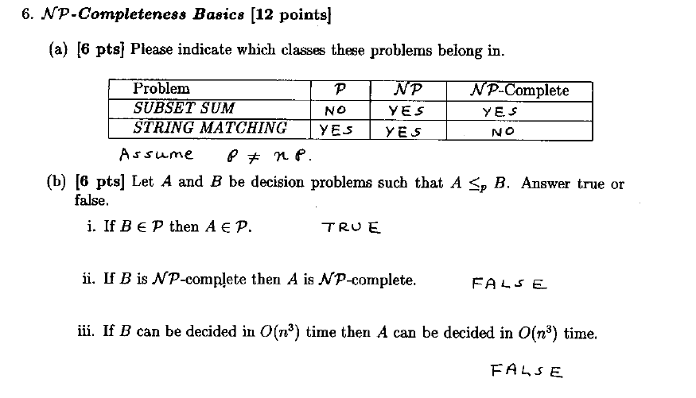

Slide 32
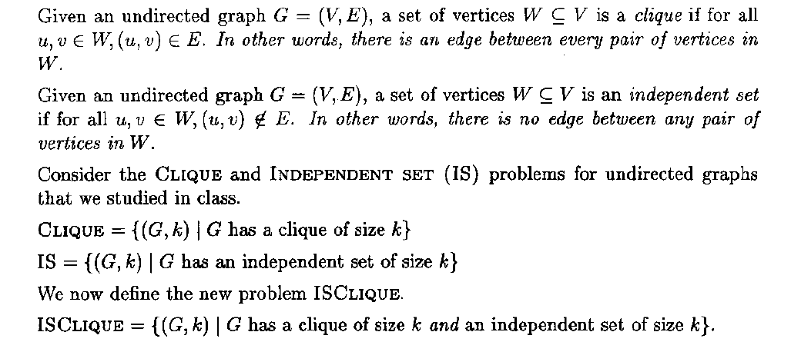


Slide 33
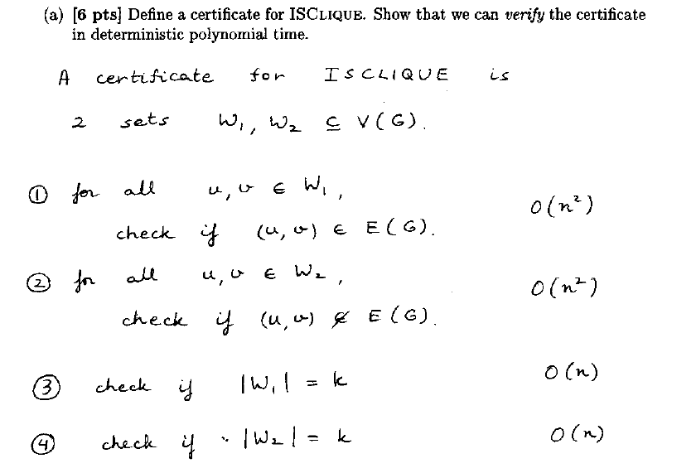

Slide 34
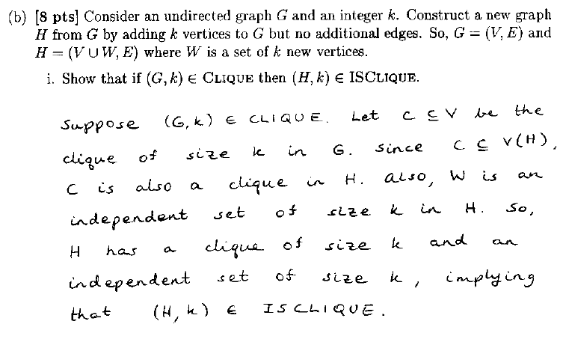

Slide 35
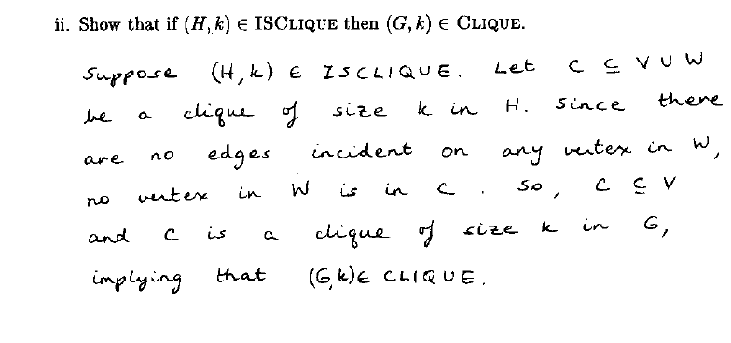

Slide 36
